Slide 1
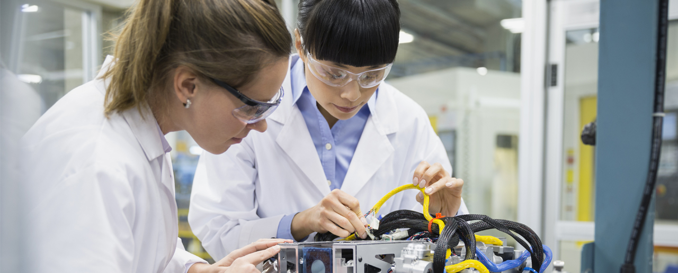
AC
info

Slide 2
Basic Math (Can be skipped )

Slide 3

















Pre knowledge
$$sinθ=cos\left({90}^{∘}−θ\right)$$
$$cosθ=sin\left({90}^{∘}−θ\right)$$
$$Sin\left(−θ\right)$$
$$=−sinθ$$
$$cos\left(−θ\right)$$
$$=cosθ$$
$$sinθ=$$
$$cos\left(θ−{90}^{∘}\right)$$
$$90°$$
$$90°$$
This shows that cos lead sin by $90°$
+
+
-
+
$$180°$$
$$0°$$
$$180°$$
$$0°$$
-
-
-
+
$$270°$$
$$270°$$

Slide 4





Pre knowledge
$${\left(Sinx\right)}^{2}$$
$$Sinx$$
$$Cosx$$
$$|Sinx|$$
$$Sin2x$$

Slide 5
Understanding Average Value

Slide 6










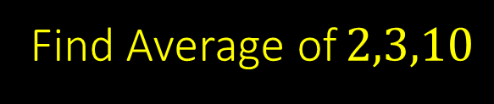


Average value
$$⇒For v_{1},v_{2},v_{3}...$$
$$≫For v=f\left(t\right)$$
Area under$v−t$curve
$$v_{1}+v_{2}+v_{3}+...$$
$$V_{avg}=\frac{{ v}_{1}+v_{2}+v_{3}+...}{ }$$
$$\int{v.dt}$$
$$n$$
$$v_{avg}=\frac{ }{ }$$
Question
Find Average of$2,3,10$
$$\int{dt}$$
Solution
$$t_{2}−t_{1}$$
$$=\frac{2+3+10}{3}$$
$$=5$$

Slide 7















Question
Question
$$V$$
$$if v=4t find average in 4s$$
?
$$\int{v.dt}$$
Solution
$$v_{avg}=\frac{\int_{0}^{4}{4t.dt}}{4−0}$$
$$v_{avg}=\frac{ }{ }$$
$$\int{dt}$$
$$4$$
$$6$$
?
$$=\frac{4{\left[{t^{2}}/2\right]}_{0}^{4}}{4−0}$$
Solution
Area under$v−t$curve
$$=\frac{ }{ }$$
$$=\frac{\frac{1}{2}4V+2V}{6}$$
$$=8$$
$$t_{2}−t_{1}$$

Slide 8




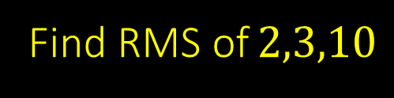







RMS value
[Root Mean square] value
$$≫For v_{1},v_{2},v_{3}...$$
$$≫For v=f\left(t\right)$$
$$v_{rms}=\sqrt{\frac{v_{1}^{2}+v_{2}^{2}+v_{3}^{2}+...}{n}}$$
$$v_{rms}=\sqrt{\frac{\frac{ \frac{A}{b}}{ \frac{A}{b} }}{\frac{ \frac{A}{b}}{ \frac{A}{b} }}}$$
$$Area under v^{2}−t$$
$$v_{1}^{2}+v_{2}^{2}+v_{3}^{2}+...$$
$$\int{v^{2}.dt}$$
$$n$$
Question
Find RMS of$2,3,10$
$$\int{dt}$$
Solution
$$v_{rms}=\sqrt{\frac{2^{2}+3^{2}+{10}^{2}}{3}}$$
$$t_{2}−t_{1}$$

Slide 9
















Question
$$V$$
$$6$$
$$v_{rms}=\sqrt{\frac{\frac{ \frac{A}{b}}{ \frac{A}{b} }}{\frac{ \frac{A}{b}}{ \frac{A}{b} }}}$$
$$2$$
$$\int{v^{2}.dt}$$
$$4$$
$$6$$
?
$$\int{dt}$$
Solution
$$v_{rms}=\sqrt{\frac{Area of v^{2} −t}{Base}}$$
$$V^{2}$$
$$v_{rms}=\sqrt{\frac{Area under v^{2}−t }{t_{2}−t_{1} }}$$
$$36$$
$$Area under v^{2}−t$$
$$4$$
$$t_{2}−t_{1}$$
$$Area=4×4+36×2$$
$$4$$
$$6$$

Slide 10











$$Avg$$
$$RMS$$
A
$$≫DC$$
$$A$$
$$A$$
A
$$≫Asin\left(ωt\right)$$
$$\frac{2A}{π}$$
$$\frac{A}{\sqrt{2}}$$
A
$$≫Traingle$$
$$\frac{A}{2}$$
$$\frac{A}{\sqrt{3}}$$

Slide 11




Special case
RMS value : AC+AC of same $ω$
$$y=Asin\left(ωt\right)+Bsin\left(ωt+{60}^{o}\right)$$
RMS value :AC+DC or AC+AC of different $ω$
$$y=A+Bsin\left(ωt\right)$$
$$y=Asin\left(ωt\right)+Bsin\left(2ωt+{60}^{o}\right)$$

Slide 12



$$⇒3\sin\left(ωt\right)+4cos⁡(ωt)$$
$$⇒6\sqrt{2}+3\sin\left(ωt\right)$$
$$⇒6\sqrt{2}+3\sin\left(ωt\right)+4cos⁡(ωt)$$
7
3

Slide 13

$$≫Random$$

